Slide 1
Home Depot Attack 2014
By Lim Hui Xiang(S10242598)
Huang Wen(S10241971)
Vishwa(S10240086)
Ernest(S10242175)

Slide 2
TABLE OF CONTENTS
01
02
03
04
05
06
Introduction
Attack and damages
How the attack took place
Security domains involved
Actions taken
Related attacks

Slide 3
01
Introduction

Slide 4
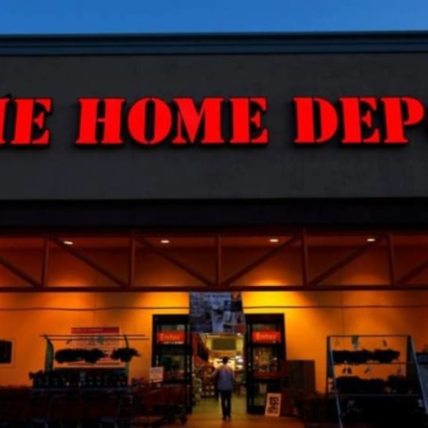
General Information
In year 2014 Home Depot has faced their largest data breach yet. In total, the cybercriminals were able to steal data of over 50 million credit card details and 53 million email addresses.

Slide 5
What will we be doing this lesson?
In this bite-sized lesson, we will be going through the attack that home depot faced in 2014, explaining what are the possible vulnerabilities that led to the attack and lastly, the consequences for a data breach.

Slide 6
Target Audience and purpose
This lesson was made for individuals who have little to no knowledge on cybersecurity with the goal of raising awareness on cybersecurity vulnerabilities.
Notes:
So that people watching our materials can prevent from making the same mistake as home depot.

Slide 7

What will you learn by the end of this lesson?
Vulnerabilities
Actions taken
The Vulnerabilities leading up to the attack
Actions taken to patch up the vulnerabilities
Back to the content page

Slide 8
02
Attacks and Damages

Slide 9


Information on the attack
01
02
03
The attack occurred between April and September 2014
Attack revolves around a malware which is a BlackPOS variant ​
Malware was customed created and it was unprecedented
Notes:
And this made it harder for the company, home depot to detect and remove the malware

Slide 10



More information on the attack
Targeted at the POS(Point Of Sale) system. ​
Goal was to steal unauthorised information ​
E.g. credit card details and email addresses.

Slide 11
How does the BlackPOS malware work
It disguises itself as an antivirus software. It records all running processes and then steals data from payment cards and sends it to the attacker's servers.

Slide 12

$179 million
50 Million
53 Million
Estimated Damages and Costs
In damages
Credit card details stolen
Email addresses stolen
Back to the content page

Slide 13
03
How the attack took place

Slide 14


TIMELINE
Step 1
Step 2
Step 3
Step 4
Step 5
Preparation for attack
Infiltrating system
Installing malware
Stealing of data
Obtaining important credentials

Slide 15

Preparation for Attack
Attackers took note of home depot’s slow response to improving its security over the years
Created an unprecedented BlackPOS variant which avoids detection from anti-virus software
Notes:
This means that attackers may have been more enticesd to attack home depot as they though that the slow response to security would mean that there wld be more bulnerabilitieies

Slide 16




Obtaining important credentials
Phishing emails were sent to dupe third-party vendor’s employees to give out important credentials.
Notes:
Phising emails help toinfiltratng the system

Slide 17
Infiltrating System
01
02
03
Infiltrated the network system successfully via stolen credentials
Attackers came across main computer operations ran on windows
Found a weakness in windows system
04
Exploited weakness to gain deeper access to home depot’s entire system
Notes:
Firsylt, the atackers
They then
After that

Slide 18

Installing malware and Stealing data
Attackers installed a series of custom-built malware(BlackPos) on
POS systems
Gained unauthorized access to private information found at self-checkout terminals
This includes credit card information and email addresses
Back to the content page

Slide 19
04
Security Domain involved

Slide 20




Security Domains Involved
Data domain
Network domain
Software domain
End-user domain

Slide 21


1. Data
Home Depot encryption of customer’s data was weak.
Attackers gain access to customer’s credit card and email address information more easily

Slide 22


2. Software
Home Depot’s anti-virus software was unable to detect the malware implanted into the POS system by the attacker.
This allowed the malware to steal data for longer periods of time.

Slide 23


3.End-User
Attackers stole important credentials from third-party vendors via phishing.
Allowing them to gain access to the network system of home depot and carry out the attack

Slide 24
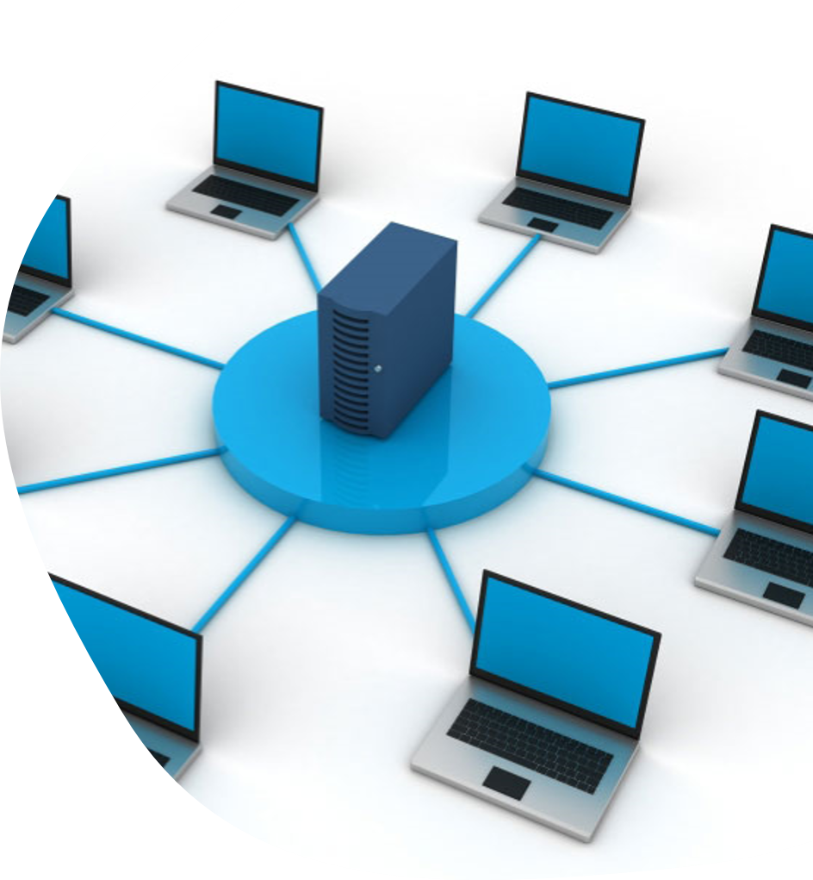

4.Network
The network system lacks sufficient security to:
Detect and prevent unauthorized access
Prevent malware from being inserted into the network system.

Slide 25
Network Domain(Result)
This resulted in
Unauthorized access to the network by the attacker
Allowing the attacker to deploy the malware to the network system
Back to the content page

Slide 26
05
Actions taken

Slide 27


Actions taken by status(company)
Home depot implement usage of a new encryption technology that is provided by voltage security. They implemented the technology to 1,977 U.S. stores and 180 Canadian stores.

Slide 28



How the new technology works
01
Takes raw data, payment data and credit card details
02
Make it unreadable
Notes:
Encrypt the data to make it unreadable and this makes it such that even if attackers steal the unauthorised information, they would still not be able to make sense of it and hence it would be more secure

Slide 29

EMV Chip-and-PIN-technology
Home Depot also implemented the usage of an EMV Chip-and-PIN-technology in order to further protect card information. It acts as additional layers of protection.

Slide 30

What is an EMV chip
EMV stands for Europay, Masterpay and Visa
Uses metallic chip instead of magnetic stripe to hold of card information
More secure
Prevent unauthorised access to card information

Slide 31
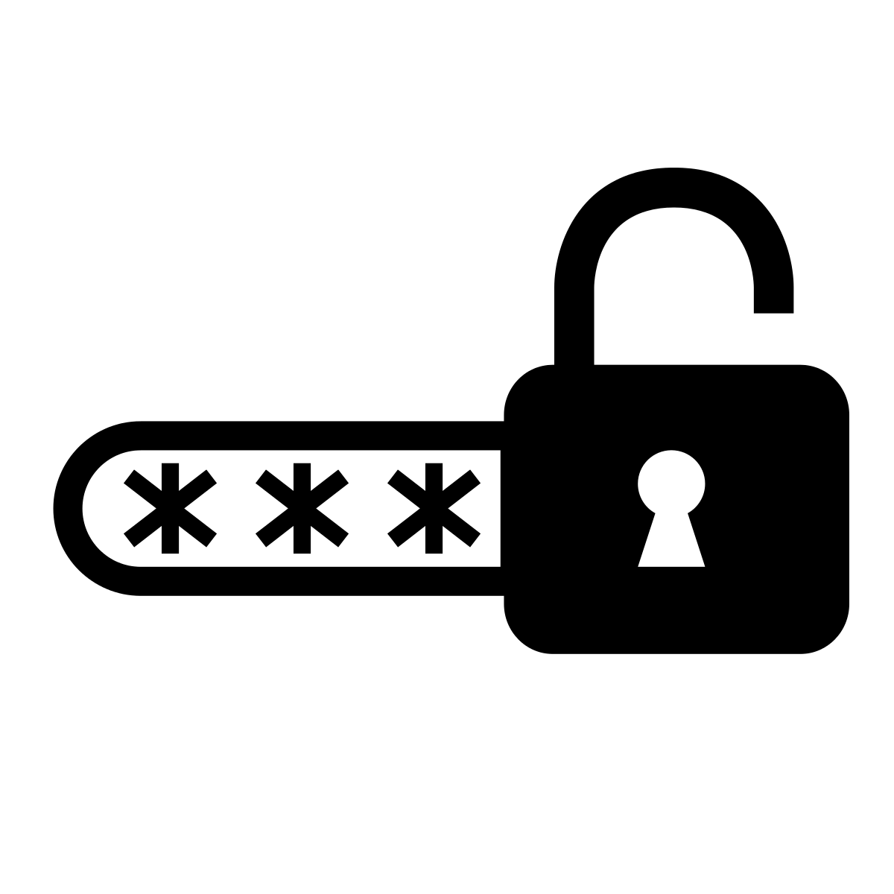


How does PIN work
Authorised user
(with pin)
Enter correct pin
Gain access to data
Unauthorised user
(without pin)
Enter wrong pin
Gain access to data
Notes:
So how the pin works is when basically authorised user would have the correct pin and if they enter it correctly, they would be able to gain access to data while unauthorised users would not have the correct pin in their disposable and hence they would not be able to gain access to data.

Slide 32


Actions taken by Authority
The US Government imposed a settlement on home depot where they have to pay $17.5million to U.S states.
Back to the content page

Slide 33
05
Related Attacks

Slide 34
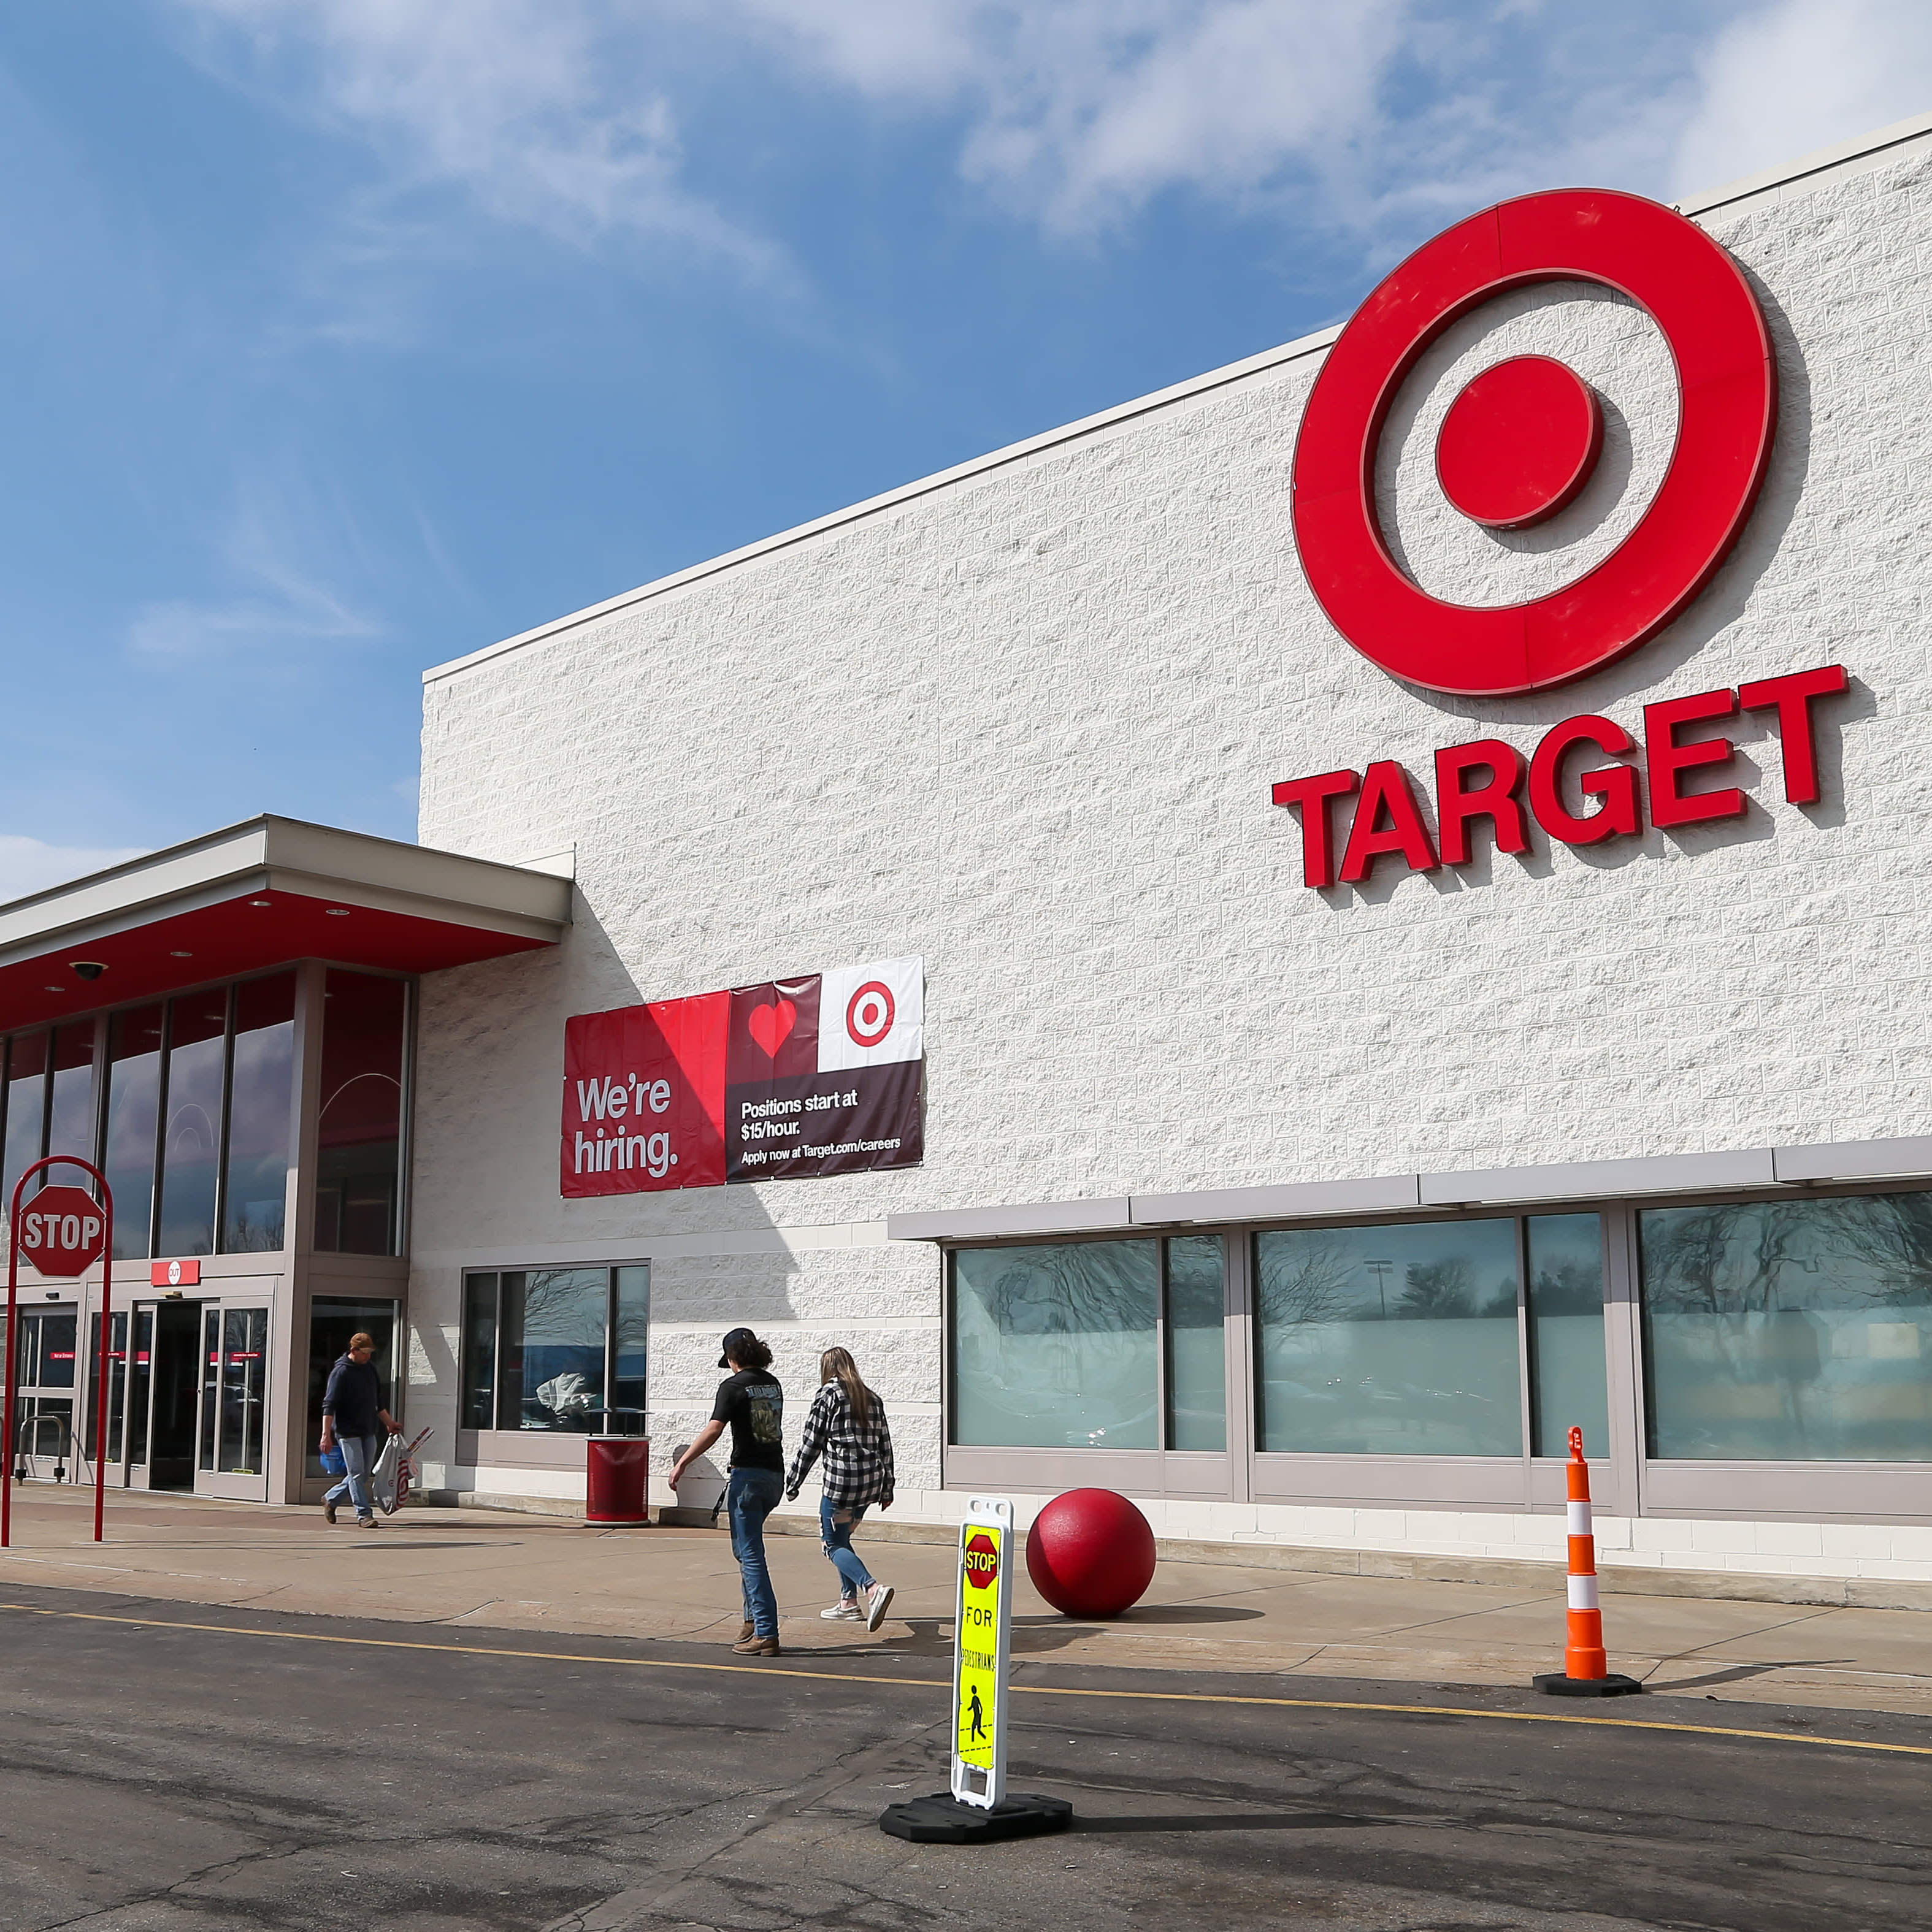
Target Data breach 2013(How it happened)
01
Attacker gained access to the target’s network via
stolen credentials from third-party vendors acquired via phishing.
02
After gaining access, they implanted malware into the system​

Slide 35


Target Data breach 2013(Effect)
40 million credit and debit card records stolen
70 million customer records stolen

Slide 36
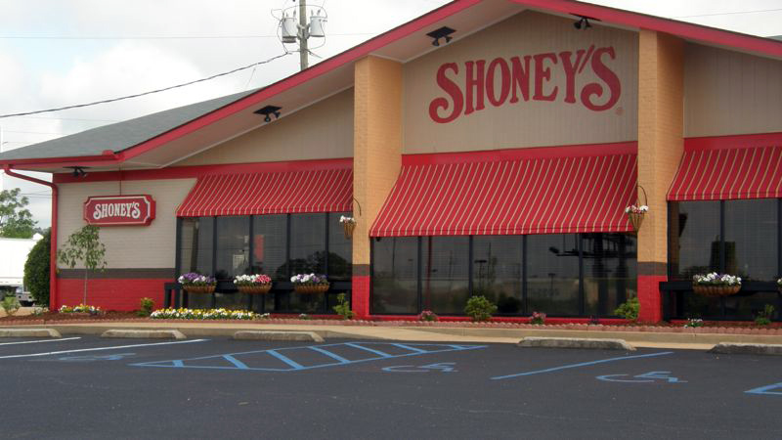
Shoneys 2017 attack
December 27,2016 to March 6,2017
A Malware was remotely downloaded in Shoney's POS systems in 37 restaurants
Attacker gain access to customer payment card information and stole cash from it.
Back to the content page

Slide 37
Team Learning

Slide 38
What we learnt from the attack
Vulnerability in cybersecurity domains
Different systems and malware
Consequences of data breaches
Areas for improvement

Slide 39
1.Vulnerabilities in cybersecurity domains
Employees and third-party’s vendors in these companies lack sufficient training on the cyber security attack vectors​
Software Systems lack the constant updates to provide up to date protection
Access to systems for third-party vendors was too laxed

Slide 40
2.Different systems and malware
Learnt what a POS system is and how it works​
Learnt the different types of malware that target POS systems such as BlackPOS​
Learnt how the BlackPOS malware works

Slide 41
3.Consequences for data breach
Huge losses for the company.​
Pay fines/settlements to the government.
​
Loss of reputation for the company.
Notes:
Involved
Companies with data breaches
affected

Slide 42
4.Areas for improvement
Constant security updates are essential​
Areas containing valuable information need to be regularly checked​
Employees must be better trained on social engineering scams​
All third-party vendors need to work with the main company to ensure complete cybersecurity in all sectors

Slide 43
Individual Learning

Slide 44
Hui Xiang
Learnt that end-users domain in an organisation are extremely vulnerable to social engineering attacks.
Learnt that a data breach can have severe consequences on a company, causing them to lose money, reputation and trust
Learnt that malwares in modern day society is extremely dangerous as they can steal unauthorised information

Slide 45
Ernest
Malware can be modified to carry out specific tasks such as avoiding detection from an intrusion detection system​
The point of attack may not start from the organization targeted but from third-party vendors​
As long as there is a vulnerability, there will be room for attackers to exploit it, which may cause a chain reaction, causing other parts of the system to get affected
Notes:
Learned how versatile malware is

Slide 46
Huang Wen
The end user domain is the weakest domain among the seven domains.​
Many end-user unknowingly give out sensitive information to attackers​
Attackers often use the information stolen from the end-user to launch the attack successfully.​
End-user cybersecurity education is important.
Notes:
This education allows end-user to learn about social engineering techniques and some examples of end-user attack vectors.
This can reduce the chances of attackers getting sensitive information or data needed from the end-user to launch the attack.

Slide 47
Vishwa
Learnt about different types of malware, specifically POS targeted malwares such as BlackPOS​
Learnt how crucial human vulnerability is for hackers to perform attacks​
Learnt how to make infographics in powerpoint

Slide 48
Team Contribution

Slide 49




Members of the team
Hui Xiang
Ernest
Vishwa
Huang Wen

Slide 50
CONTRIBUTIONS
Hui Xiang: Introduction, Attacks and damages, Actions taken
Ernest: How the attack Happened, related attacks
Huang Wen: Security Domain Involved, related attacks
Vishwa: Related attacks, attacks and damages

Slide 51
Reference
https://slate.com/technology/2022/04/breached-excerpt-hartzog-solove-target.html​
https://www.bankinfosecurity.com/home-depot-53-million-emails-stolen-a-7537​
https://whatismyipaddress.com/homedepot-hack​
https://www.usatoday.com/story/money/business/2014/11/06/home-depot-hackers-stolen-data/18613167/​
https://www.cnbc.com/2022/06/07/target-markdowns-plan-to-cut-inventory.html​
https://www.pcmag.com/news/malware-infected-shoneys-restaurants-for-months​
https://www.scmagazine.com/news/security-news/hacker-served-shoneys-pos-malware-for-three-months

Slide 52
Reference
https://whatismyipaddress.com/homedepot-hack#:~:text=The%20terminals%20were%20identified%20on,then%20waited%20for%20an%20opportunity​
https://www.arctitan.com/blog/case-study-data-breach-cost-home-depot-179-million/#:~:text=Last%20year%2C%20Home%20Depot%20agreed,those%20affected%20by%20the%20breach.​
https://www.bankinfosecurity.com/examining-home-depot-breach-a-7339​
https://duo.com/decipher/home-depot-settles-with-states-over-2014-data-breach#:~:text=Attackers%20had%20infiltrated%20Home%20Depot's,to%20implement%20specific%20security%20measures.​
https://www.trendmicro.com/vinfo/pl/security/news/cyber-attacks/home-depot-confirms-breach-of-us-and-canada-stores-reported-to-be-largest-in-record​
https://ir.homedepot.com/news-releases/2014/11-06-2014-014517315​
https://www.arctitan.com/blog/case-study-data-breach-cost-home-depot-179-million/​
https://www.arctitan.com/blog/case-study-data-breach-cost-home-depot-179-million/#:~:text=The%20Home%20Depot%20data%20breach,around%2053%20million%20email%20addresses.​
https://squareup.com/us/en/townsquare/what-pos-system#:~:text=A%20point%20of%20sale%2C%20or,business%20to%20make%20those%20sales.​
https://www.webtitan.com/blog/cost-retail-data-breach-179-million-home-depot/#:~:text=In%202016%2C%20Home%20Depot%20agreed,monitoring%20services%20to%20breach%20victims.​
https://ir.homedepot.com/news-releases/2014/11-06-2014-014517315​
https://www.chase.com/personal/credit-cards/education/basics/what-is-emv-chip-how-it-stores-your-data​
https://digitalguardian.com/blog/what-point-sale-pos-malware-how-it-works-and-how-protect-your-pos-system​
https://www.channelnewsasia.com/business/home-depot-posts-record-sales-demand-diy-products-surges-623621​
https://cwatch.comodo.com/images-new/what-is-the-purpose-of-hacking.png

Slide 53
Reference
https://www.google.com/url?sa=i&url=https%3A%2F%2Fwww.missioncriticalmagazine.com%2Farticles%2F93186-biological-viruses-versus-computer-viruses&psig=AOvVaw2i9wsvH1Mc74L_1CFkXWvB&ust=1656242066817000&source=images&cd=vfe&ved=0CAwQjRxqFwoTCLiT5dS8yPgCFQAAAAAdAAAAABAY​
https://www.openaccessgovernment.org/timportance-of-cybersecurity-against-cyber-attacks/80457/​
https://www.cisco.com/c/en/us/products/security/advanced-malware-protection/what-is-malware.html​
https://blogfeed.ulistic-projects.com/wp-content/uploads/2018/12/Phishing.png​
https://blog.planview.com/wp-content/uploads/2020/01/Top-6-Software-Development-Methodologies.jpg​
https://www.pcwdld.com/systems-management#wbounce-modal​
https://towardsdatascience.com/why-and-how-to-use-pandas-with-large-data-9594dda2ea4c?gi=68acacc7be85​
https://www.careersinaudit.com/article/the-importance-of-corporate-governance-in-an-organisation/​
https://www.google.com/url?sa=i&url=https%3A%2F%2Fwww.teknowlogic.com%2Fen%2Fotros-cursos%2Fentrenamientos-usuario-final%2F&psig=AOvVaw2sKTJgFVpcTjA3oRtO9cul&ust=1656243127213000&source=images&cd=vfe&ved=0CAwQjRxqFwoTCLj58uLAyPgCFQAAAAAdAAAAABAD

Slide 54
Reference
https://bournetocode.com/projects/GCSE_Computing_Fundamentals/pages/3-5-1-comp_net.html​
https://sensorstechforum.com/blackpos-frameworkpos-backoff-pos-malware-attacks-expected-in-holiday-shopping-season/​
https://learn.g2.com/hubfs/What_is_Information_Technology.jpg​
https://assets.website-files.com/60a3c1fc44c5715c395770e7/60df8191a884c0804de8b15d_Depositphotos_24064653_l-2015.jpeg​
https://www.channelfutures.com/mssp-insider/fortinet-sold-chinese-made-equipment-to-military-pays-big-settlement​
https://www.idstrong.com/sentinel/that-one-time-target-lost-everything/#:~:text=The%20Target%20data%20breach%20occurred,party%20vendor%20in%20Nov%202013.​
https://home.sophos.com/en-us/security-news/2020/does-malware-exist​
https://www.nytimes.com/2014/09/20/business/ex-employees-say-home-depot-left-data-vulnerable.html​
https://www.freeiconspng.com/images/encryption-icon​
https://thenounproject.com/icon/malware-2481506/​
https://www.pngwing.com/en/free-png-dchmb/download
https://thenounproject.com/icon/malware-2481506/

Slide 55
THANKS!
Do you have any questions?
youremail@freepik.com
+91 620 421 838
yourcompany.com
Please keep this slide for attribution

Slide 56


Slide 57

The End
Thank you for listening
Go back to the first page

